Slide 1
Numerical simulation of Foams
Tony Hau
UNDER THE SUPERVISION OF PROFESSOR ZHANG RUI. This project owes much effort to prof zhang and support from teaching assistant kyle chan chung wing

Slide 2
Objective of this presentation
To explain the principle behind bubble formation
To demonstrate two numerical simulation to simulate bubble formation
To explain some key results from the two simulations
Note: All videos included in this presentation are set to have framerate equal to 6

Slide 3




Main paper reference: https://raw.githubusercontent.com/erleben/FOAM/master/doc/bondorf.17.master_thesis.pdf
Simulation of Two-Dimensional Dry Foam Using a Vertex Model
https://journals.plos.org/plosone/article?id=10.1371/journal.pone.0215836
Dynamics and stationary configurations of heterogeneous foams

Slide 4
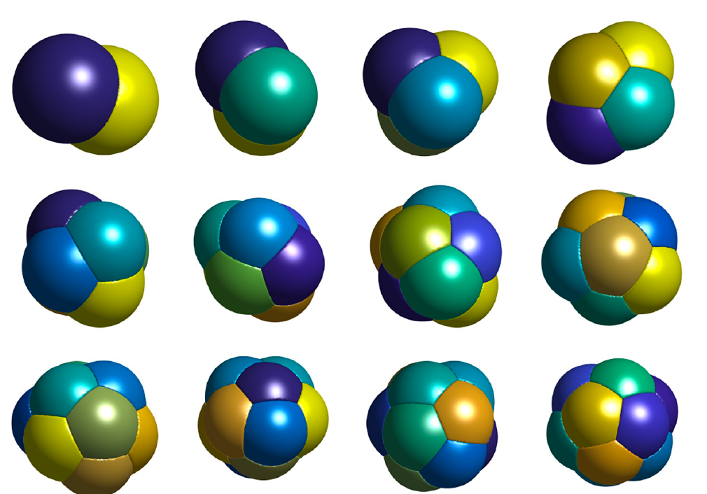
Principle behind bubble formation
To minimize total length/surface area
Therefore, we can let total length/surface area be the energy of system
The question becomes finding a bubble configuration to minimize energy
In 2D case, we try to minimize the total length; in 3D case, we try to minimize the surface area

Slide 5
Principle behind bubble formation
If we assume that pressure across whole bubble configuration is uniform(no pressure difference), bubble should not shrink or enlarge(primary driving force behind diffusion is pressure). We can therefore assume as well that volume/area in 2D/3D bubble do not change.

Slide 6
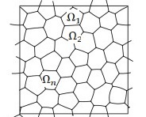
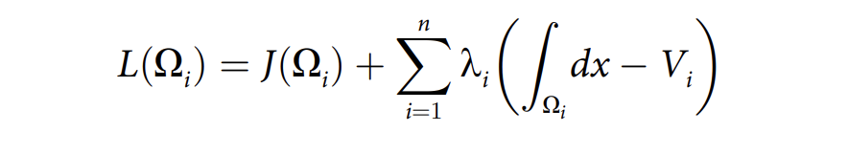
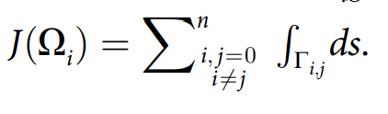
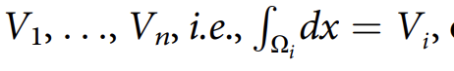
Principle behind bubble formation
We can define the Lagrangian(energy) of a 2D bubble configuration as
is the total boundary length
is the area of each bubble (a constraint)
We minimize the total boundary length, subjected to the constrain that each bubble has a fixed area

Slide 7
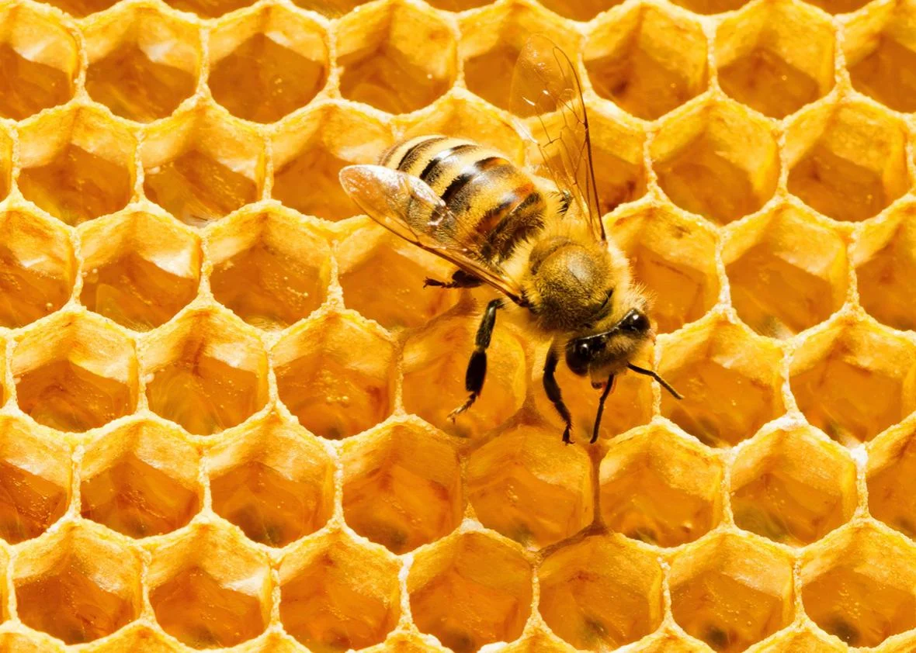
Honey-comb structure and Plateau’s Law (120 degree)

Slide 8
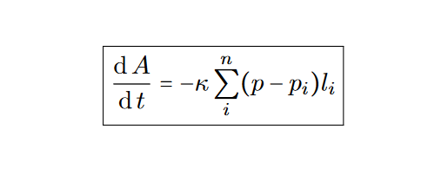
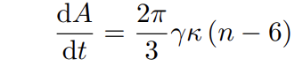
Principle behind bubble formation
But in real world, there may be pressure difference across difference bubbles.
Specifically, gases inside a high pressure bubble will diffuse into low pressure bubble. The low pressure bubble will enlarge and the other one will shrink
von Neumann’s law for bubble:
A is the area of a bubble
t is time
γ is surface tension of the liquid medium
κ IS diffusion constant of the liquid which controls the transfer rate
n is the number of films that bubble possesses.

Slide 9
Two bubble numerical simulations
First simulation is to assume that pressure inside bubble configuration is uniform → simulation result should be static, obeying Plateau’s Law (120 degree) and honey-comb shape
Second simulation is to assume that pressure differences exist within bubble configuration, and hence diffusion occurs → simulation result should give shrinking and enlarging bubbles

Slide 10
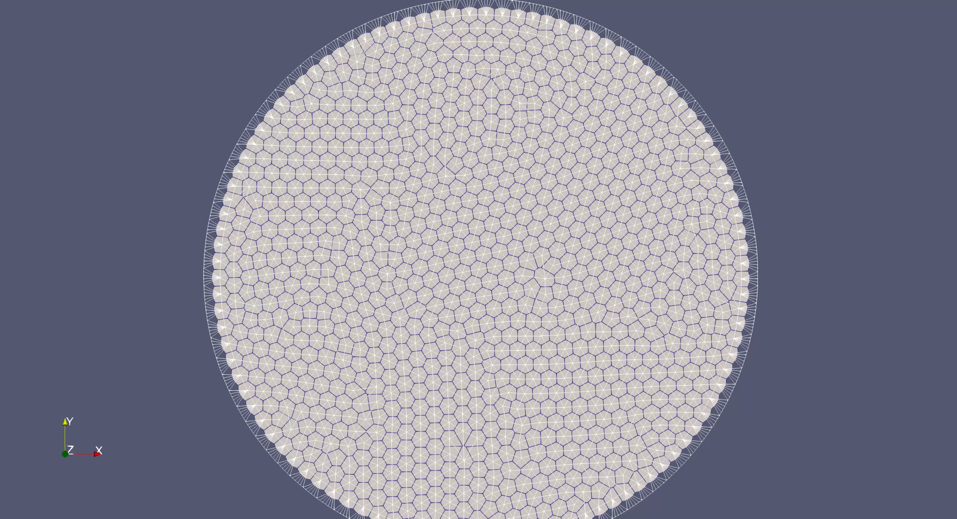
Result from first simulation

Slide 11
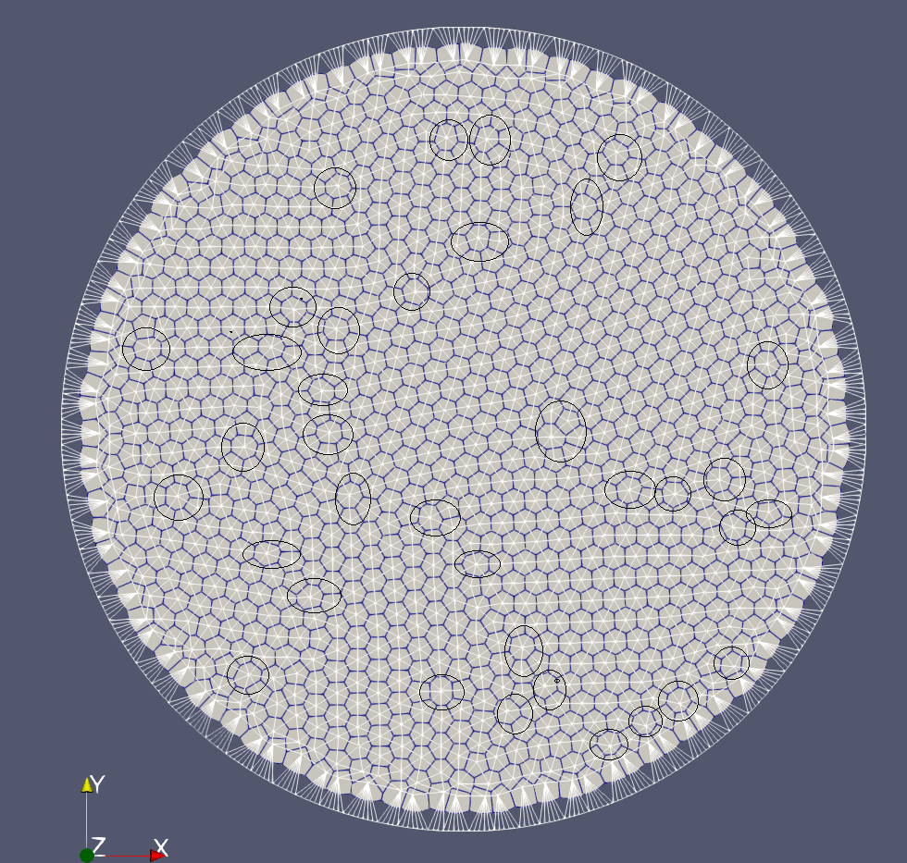
Result from first simulation – some interesting statistics
Number of sides of cells | Frequency
5 | 121 (8.09%)
6 | 1340 (90.0%)
7 | 35 (2.34%)
 | Total: 1496
At frame 100

Slide 12
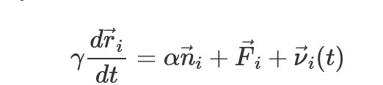
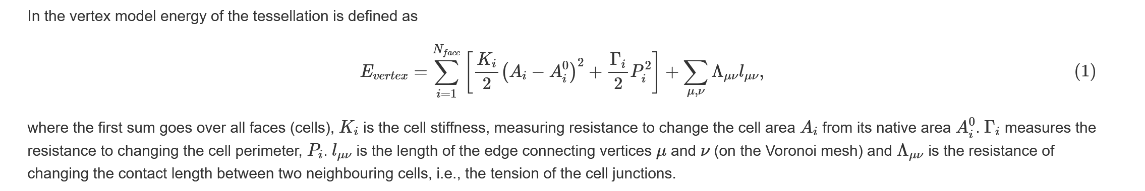
Addition to the result from first simulation
During simulation, we also try to change some parameters to fit this model to simulate real cell movements.
In particular, we include an energy term that allows bubbles to change its area, some thermal random noises and a self-propulsion term that allows cells to move by itself.
what we have added on top of first simulation

Slide 13
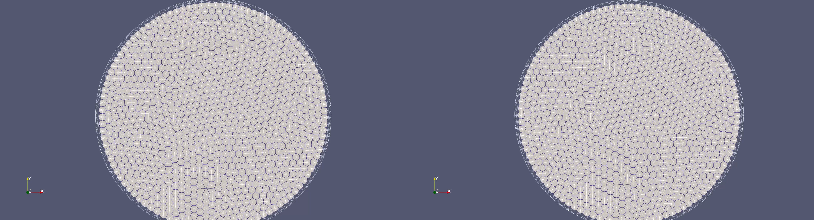
Addition to the result from first simulation – Adding chaotic thermal random motion
Left simulation: with the width of the distribution of Gaussian thermal random motion equal to 0.01
Right simulation: with the width equal to 2

Slide 14
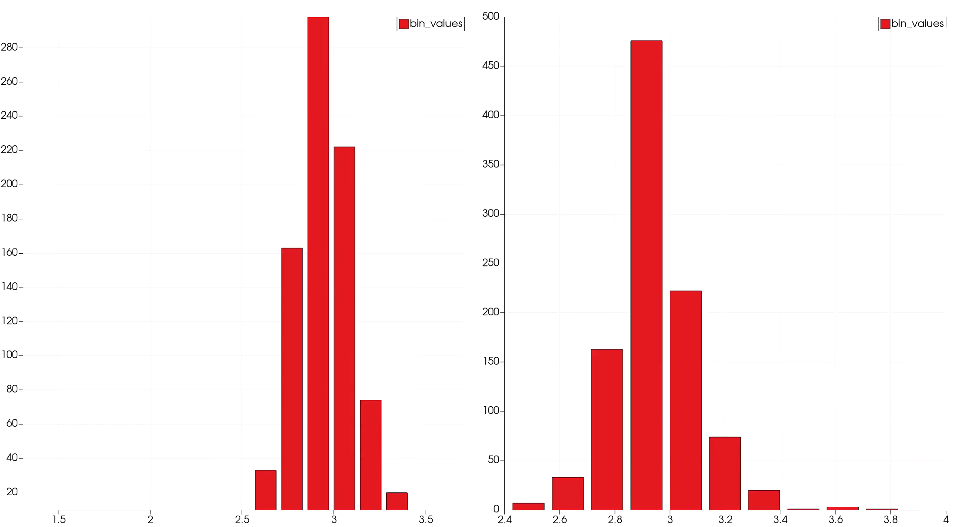
Addition to the result from first simulation – Adding chaotic thermal random motion
Left simulation: area distribution of individual cells with width equal to 0.01
Right simulation: area distribution of individual cells with width equal to 2

Slide 15
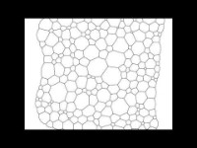
Result from second simulation
Reference: https://www.youtube.com/watch?v=7lNKYKVtlTQ

Slide 16
Summary
Bubble configuration is governed by the minimization of length( or energy) in 2D case, or minimization of surface area in 3D case.
If pressure inside bubbles is uniform, minimized configuration is static, with nearly all angles being 120 degree and bubbles being hexagonal.
If pressure is considered, minimized configuration is similar to that with uniform pressure. Only difference is that bubbles will shrink and enlarge continuously.
In the first simulation we successfully simulate uniform pressure configuration by considering minimization of length(squared) and some physical constraints such as repulsive potential when two cells are too closed to each other.
We add some parameters to on top of first simulation to simulate biological cell movement.
We successfully simulate bubble movement when pressure is not uniform in second simulation.

